Slide 1
Graphs and Applications

Slide 2
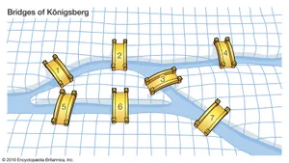
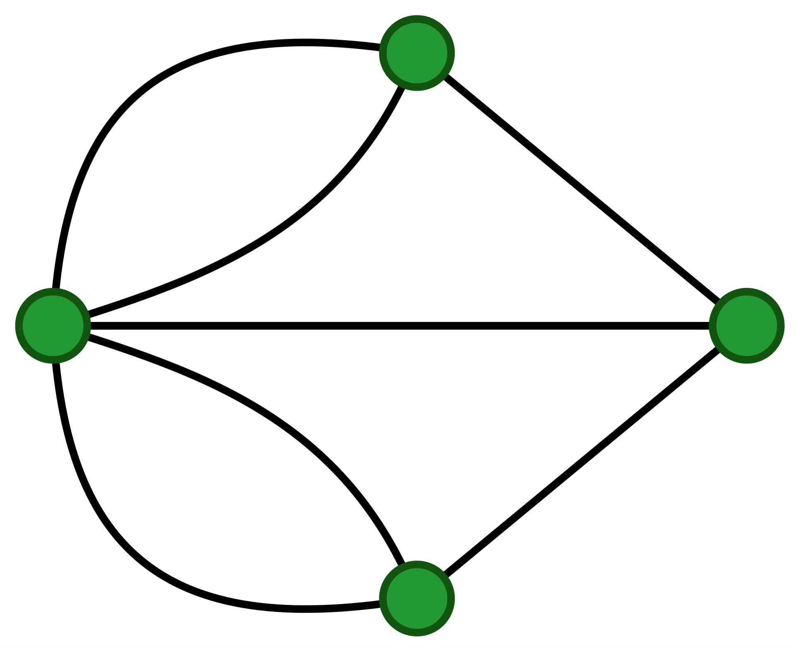
Objectives (1 of 2)
To model real-world problems using graphs and explain the Seven Bridges of Königsberg problem.
To describe the graph terminologies: vertices, edges, simple graphs, weighted/unweighted graphs, and directed/undirected graphs.
To represent vertices and edges using lists, edge arrays, edge objects, adjacency matrices, and adjacency lists.
To model graphs using the Graph interface, the AbstractGraph class, and the UnweightedGraph class.
To represent the traversal of a graph using the UnweightedGraph.SearchTree class.
To design and implement depth-first search.

Slide 3
Review Trees
A tree is a collection of nodes where each node has at most 1 parent and at least 0 children
A binary tree is a tree where each node has at most 2 children
Root node: the single node with no parent, “top” of the tree
Leaf node: a node with no children
Subtree: a node and all its descendants
Edge: connection between parent and a child
0
1
7
3
8
10
2

Slide 4
Review Trees We’ve Seen So Far
Binary Search Trees
And variant: AVL Trees
Binary Min-Heaps
14
5
8
21
6
7
3
16
22
9
8
31
15

Slide 5
Inter-data Relationships
Arrays
Trees
Graphs
Elements only store pure data, no connection info
Only relationship between data is order
Elements store data and connection info
Directional relationships between nodes; limited connections
Elements AND connections can store data
Relationships dictate structure; huge freedom with connections
C
0 | 1 | 2
A | B | C
B
B
A
C
A

Slide 6
Everything is Graphs
Everything is graphs.
Most things we’ve studied so far can be represented by graphs.
BSTs are graphs
Linked lists? Graphs.
Heaps? Also can be represented as graphs.
Those trees we drew in the tree method? Graphs.
But it’s not just data structures that we’ve discussed…
Google Maps database? Graph.
Facebook? They have a “graph search” team. Because it’s a graph
Those pictures of prerequisites in your program? Graphs.
Family tree? That’s a graph

Slide 7
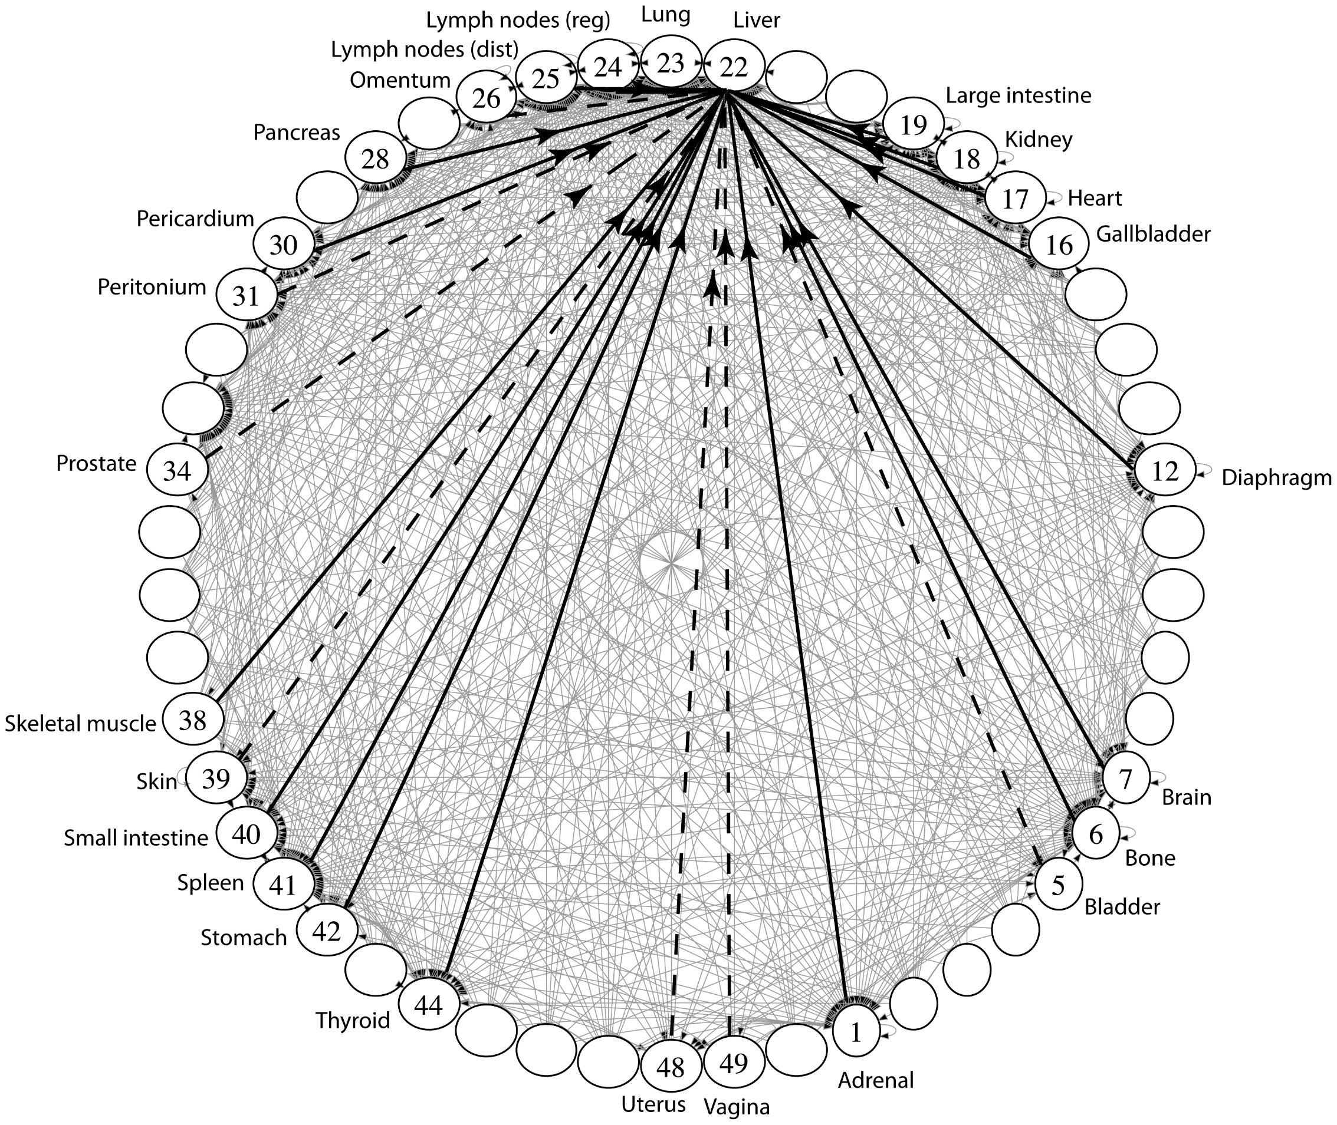
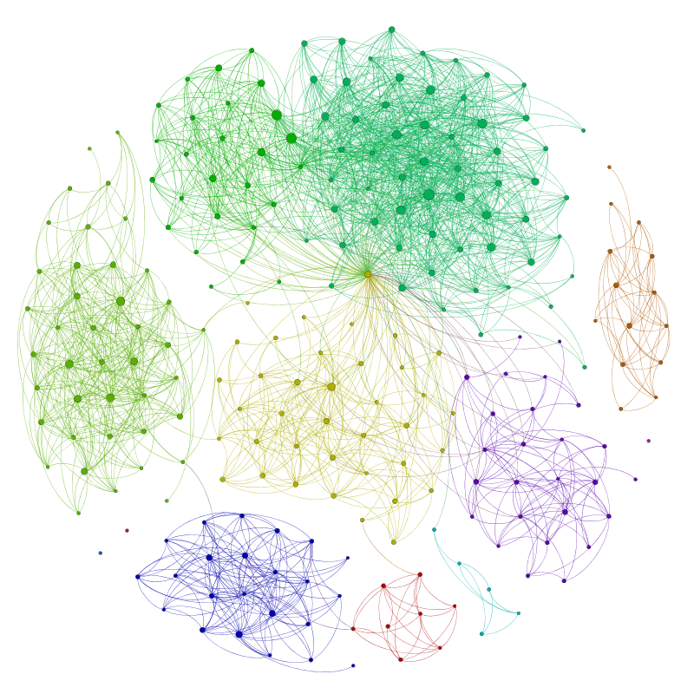
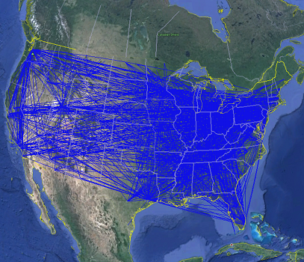
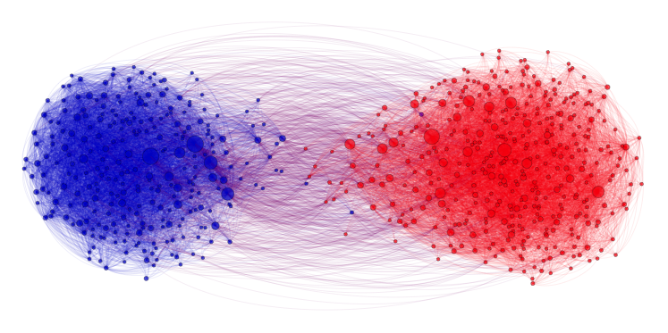
Applications
Physical Maps
Airline maps
Vertices are airports, edges are flight paths
Traffic
Vertices are addresses, edges are streets
Relationships
Social media graphs
Vertices are accounts,
edges are follower relationships
Influence
Biology
Vertices are cancer cell destinations,
edges are migration paths
Related topics
Web Page Ranking
Vertices are web pages, edges are hyperlinks
Wikipedia
Vertices are articles, edges are links

Slide 8
Graphs
V: Set of vertices
E: Set of edges
A Graph consists of two sets, V and E:
V: Set of vertices (aka nodes)
E: Set of edges (pairs of vertices)
|V|: Size of V (also called n)
|E|: Size of E (also called m)
b
( , )
a
a
c
( , )
b
a
d
( , )
c
c
b
b
a
d
a
d
c
c
f
g
h
e
e

Slide 9
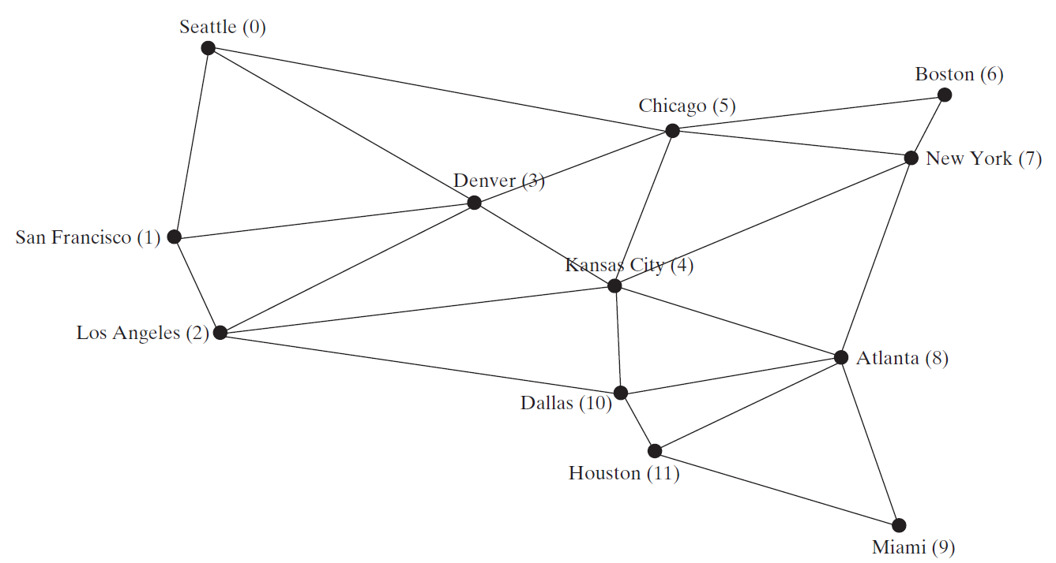
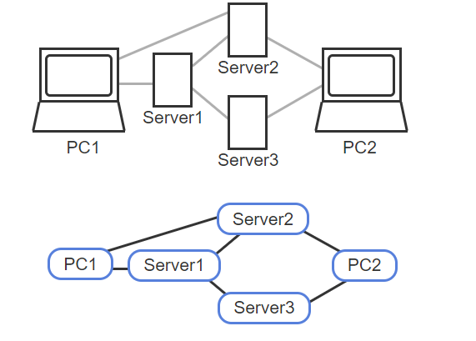
Modeling Using Graphs
In the given map
The cites(i) are vertices or nodes
The lines are called edges
A subgraph is a portion of a graph that is itself a graph

Slide 10
Directed vs Undirected; Acyclic vs Cyclic
Directed:
Undirected:
b
b
e
Acyclic:
a
d
a
d
c
c
b
b
Cyclic:
a
d
a
d
c
c

Slide 11
Labeled and Weighted Graphs
Vertex & Edge Labels
Vertex Labels
Edge Labels
b
e
c
2
c
5
a
d
a
d
a
d
b
1
b
3
c
4
Numeric Edge Labels (Edge Weights)
3
1
1
2

Slide 12
Basic Graph Terminologies
What is a graph? G=(V, E)
Define a graph
A path between two vertices
Weighted vs. unweighted graphs

Slide 13
More Graph Terminology
A Simple Graph has no self-loopelf- or parallel edges
Unless otherwise stated, all graphs in this course are simple
Vertices with an edge between them are adjacent
Vertices or edges may have optional labels
Numeric edge labels are sometimes called weights
b
a
parallel edges
f
self-loop

Slide 14
More More Graph Terminology
j
Two vertices are connected if there is a path between them
If all the vertices are connected, we say the graph is connected
The number of edges leaving a vertex is its degree
A path is a sequence of vertices connected by edges
A simple path is a path without repeated vertices
A cycle is a path whose first and last vertices are the same
A graph with a cycle is cyclic
f
g
e
d
b
c
a
i
p
n
o
m
i
p
n
o
m

Slide 15
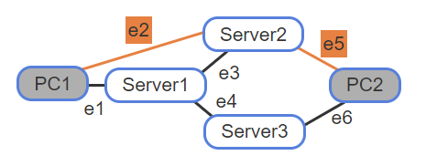
Basic Graph Terminologies
Distance
The number of edges on the shortest path between two vertices.
Notes:
PC1 and Server1 are adjacent
PC1 and Server3 are not adjacent
A path from PC1 to PC2: e1 -> e3 -> e5
Shortest path is e2 -> e2
So, Distance is 2

Slide 16
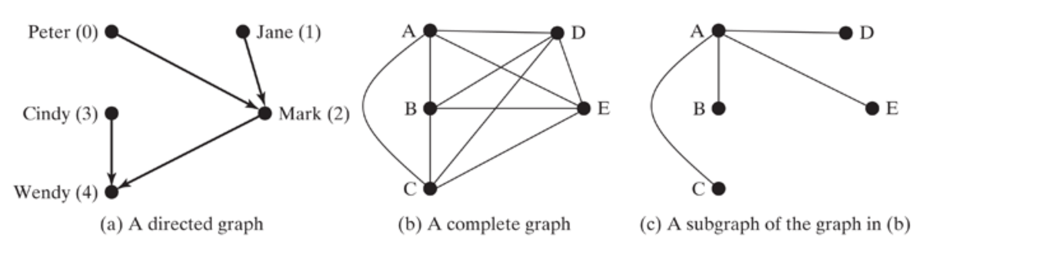
Basic Graph Terminologies
Complete graph
Every two vertices are adjacent
Subgraph of a graph G
A graph whose vertex set is a subset of G and whose edge set is a subset of that of G
Neighbor
Two vertices are neighbors if they are adjacent
Notes:
Incident : An edge in a graph that joins two vertices.
Figure (b) deg(A) -> 4 Figure (a) deg(Mark) -> 1

Slide 17
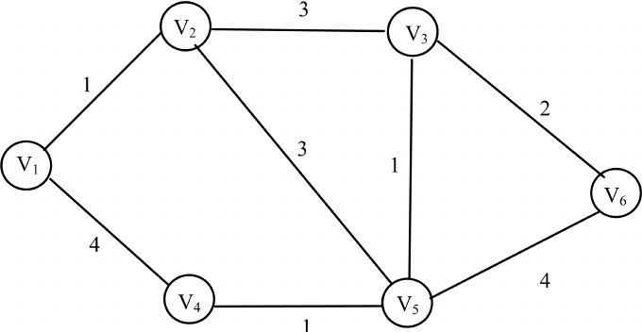
Basic Graph Terminologies
Simple path
A path that doesn’t have any loops or parallel edges

Slide 18
Basic Graph Terminologies
Cycle
A closed path that starts from a vertex and ends at the same vertex
Tree
A connected graph that does not have cycles
Spanning tree of G
A connected subgraph of G, and the subgraph is a tree that contains all vertices in G

Slide 19
Some examples
For each of the following: what should you choose for vertices and edges? Directed?
Webpages on the Internet
Vertices: webpages. Edges from a to b if a has a hyperlink to b.
Directed, since hyperlinks go in one direction
Ways to walk between campus buildings
Vertices: buildings. Edges: A street name or walkway that connects 2 buildings
Undirected, since each route can be walked both ways
Course Prerequisites
Vertices: courses. Edge: from a to b if a is a prereq for b.
Directed, since one course comes before the other

Slide 20
Lecture Outline
Graphs
Definitions
Choosing Graph Types
Graph Implementations
s-t Connectivity Problem

Slide 21
Representing Graphs
Representing Vertices
Representing Edges: Edge Array
Representing Edges: Edge Objects
Representing Edges: Adjacency Matrices
Representing Edges: Adjacency Lists

Slide 22
Representing Vertices
String[] vertices = {“Seattle“, “San Francisco“, “Los Angles”, “Denver”, “Kansas City”, “Chicago”, … };
City[] vertices = {city0, city1, … };
public class City {
}
List<String> vertices;

Slide 23
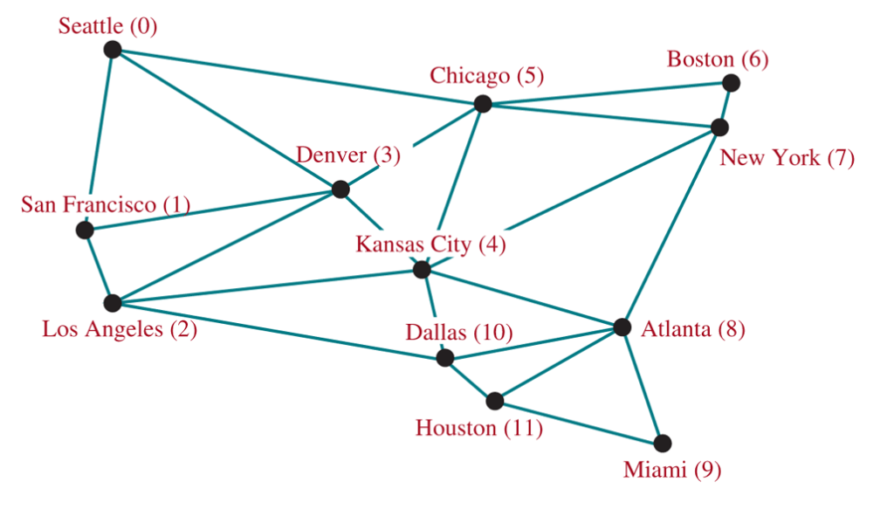
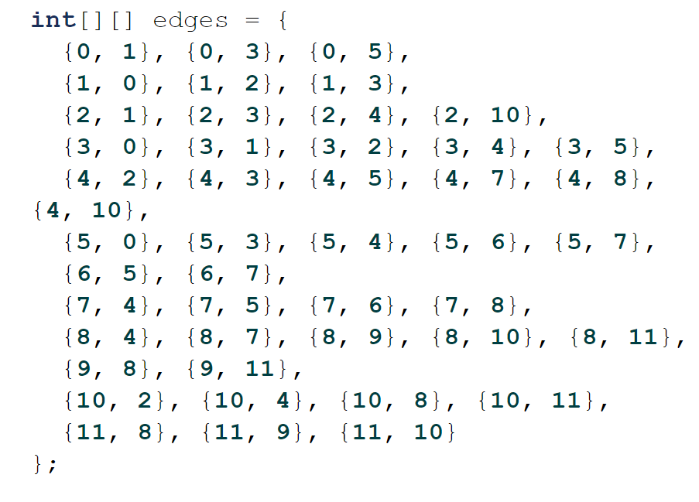
Representing Edges: Edge Array

Slide 24
Representing Edges: Edge Object
public class Edge {
int u, v;
public Edge(int u, int v) {
this.u = u;
this.v = v;
}
List<Edge> list = new ArrayList<>();
list.add(new Edge(0, 1)); list.add(new Edge(0, 3)); …

Slide 25
Adjacency Matrix
4
0
1
5
6
2
3
Create a 2D matrix that is |V| x |V|
In an adjacency matrix, a[u][v] is 1 if there is an edge (u,v), and 0 otherwise.
Symmetric for undirected graphs
 | 0 | 1 | 2 | 3 | 4 | 5 | 6
0 | 0 | 1 | 1 | 0 | 0 | 0 | 0
1 | 1 | 0 | 0 | 1 | 0 | 0 | 0
2 | 1 | 0 | 0 | 1 | 0 | 0 | 0
3 | 0 | 1 | 1 | 0 | 0 | 1 | 0
4 | 0 | 0 | 0 | 0 | 0 | 1 | 0
5 | 0 | 0 | 0 | 1 | 1 | 0 | 0
6 | 0 | 0 | 0 | 0 | 0 | 0 | 0

Slide 26
Representing Edges: Adjacency Matrix
int[][] adjacencyMatrix = {
{0, 1, 0, 1, 0, 1, 0, 0, 0, 0, 0, 0}, // Seattle
{1, 0, 1, 1, 0, 0, 0, 0, 0, 0, 0, 0}, // SF
{0, 1, 0, 1, 1, 1, 0, 0, 0, 0, 0, 0}, // LA
{1, 1, 1, 0, 1, 1, 0, 0, 0, 0, 0, 0}, // Denver
{0, 0, 1, 1, 0, 1, 0, 1, 1, 0, 1, 0}, // Kansas
{1, 0, 0, 1, 1, 0, 1, 1, 0, 0, 0, 0}, // Chicago
{0, 0, 0, 0, 0, 1, 0, 1, 0, 0, 0, 0}, // Boston
{0, 0, 0, 0, 1, 1, 1, 0, 1, 0, 0, 0}, // NY
{0, 0, 0, 1, 1, 0, 0, 1, 0, 1, 1, 1}, // Atlanta
{0, 0, 0, 0, 0, 0, 0, 0, 1, 0, 0, 1}, // Miami
{0, 0, 1, 0, 1, 0, 0, 0, 1, 0, 0, 1}, // Dallas
{0, 0, 0, 0, 0, 0, 0, 0, 1, 1, 1, 0} // Houston
};

Slide 27
Representing Edges: Adjacency Vertex List

Slide 28
Representing Edges: Adjacency Edge List

Slide 29
Representing Adjacency Edge List Using ArrayList
List<ArrayList<Edge>> neighbors = new ArrayList<>();
neighbors.add(new ArrayList<Edge>());
neighbors.get(0).add(new Edge(0, 1));
neighbors.get(0).add(new Edge(0, 3));
neighbors.get(0).add(new Edge(0, 5));
neighbors.add(new ArrayList<Edge>());
neighbors.get(1).add(new Edge(1, 0));
neighbors.get(1).add(new Edge(1, 2));
neighbors.get(1).add(new Edge(1, 3));
...
...
neighbors.get(11).add(new Edge(11, 8));
neighbors.get(11).add(new Edge(11, 9));
neighbors.get(11).add(new Edge(11, 10));

